Slide 1
Capstone Project
Cardiovascular Disease Prediction by- Souvik Bhattacharyya

Slide 2
Content
Abstract
Data Summary
Exploratory Data Analysis
Modelling
Hyperparameter tunning
Handling imbalanced dataset
Comparing different models
Conclusion

Slide 3
Abstract
Cardiovascular diseases are very common these days due to changes in lifestyle and poor eating habits. So predicting the risk of cardiovascular disease for a given person by analyzing his/her data from the past can save them if they act early against the disease. In this problem, we are given such data from over 4000 patients on 15 different attributes from an ongoing cardiovascular study on residents of the town of Framingham, Massachusetts. The goal is to predict whether a patient has a 10-year risk of future Coronary Heart Disease (CHD).

Slide 4
Data Summary
The dataset provides the patients’ information. It includes 15 attributes. Each attribute is a potential risk factor. There are both demographic, behavioral, and medical risk factors. Let us go through each one of them.
Demographic:
Sex: male or female("M" or "F")
Age: Age of the patient
Behavioral:
is_smoking: whether the patient is a current smoker ("YES" or "NO")
Cigs Per Day: the number of cigarettes that the person smoked on average in one day
Medical(history):
BP Meds: whether or not the patient was on blood pressure medication
Prevalent Stroke: whether or not the patient had previously had a stroke
Prevalent Hyp: whether or not the patient was hypertensive
Diabetes: whether or not the patient had diabetes
Medical(current):
Tot Chol: total cholesterol level
Sys BP: systolic blood pressure
Dia BP: diastolic blood pressure
BMI: Body Mass Index
Heart Rate: heart rate
Glucose: glucose level
Predict variable(desired target):
10-year risk of coronary heart disease CHD

Slide 5
Dataset Summary
This Dataset contains 3390 rows and 17 columns.
It contains six categorical features and 10 numerical features.
Null values are present in the dataset.
There are No Duplicate values present.
The dependent variable is ‘Ten-year CHD' which we need to make predictions on.
Target variable is a categorical value which means the classification machine learning models will be used for prediction.

Slide 6
Data Summary
Age
CigsPerDay
TotChol
SysBP
DiaBP
BMI
HeartRate
Glucose
Sex
Is_smoking
BPMeds
PrevalentStroke
PrevalentHyp
Diabetes
Dataset
Categorical
Numerical
Target
Ten year CHD

Slide 7
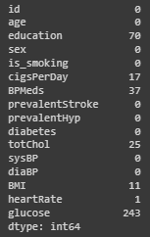
Null Values Handling
Null values are present in our data. We have to remove or replace the Null Values.
For Categorical features we have imputed the null values with the mode of that feature.
For Numerical features we have imputed the null values with the median of that feature.

Slide 8
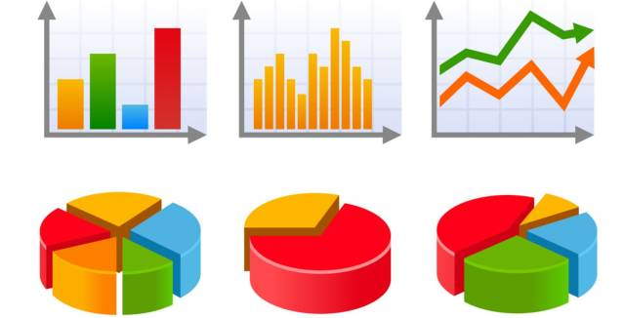
EXPLORATORY DATA ANALYSIS
Exploratory Data Analysis also known as EDA, is the process of interpreting datasets by summarizing their key properties.
EDA refers to the critical process of performing initial investigation on datasets so as discover the patterns, spot anomalies, to the hypothesis, and check assumptions with the help of summary statics and graphical representation.

Slide 9
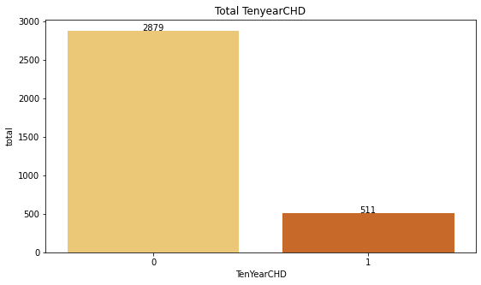
Total Ten-year CHD
Out of 3390 given patients we have 511 patients have Cardiovascular Disease
We can see that the data set is a highly imbalanced dataset as the target variable have a large difference between a patient who has CHD and who does not have CHD.

Slide 10
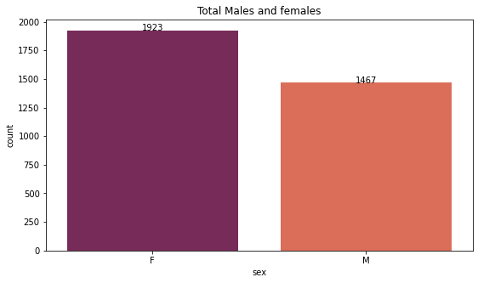
Total Males and Females
We can see that females patient are more in numbers i.e. 1923 whereas the male patient number is less which is 1467 in our dataset.

Slide 11
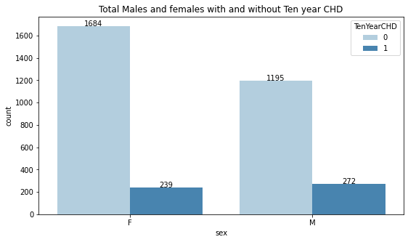
Men and Females with and without Ten Year CHD
We can see in the graph 1923 total female patient where 1684 does not have CHD and 239 have CHD.
272 male patients have CHD and 1195 patient does not have CHD a total of 1457 male patient.
We can say more percentage of male patients have CHD.

Slide 12
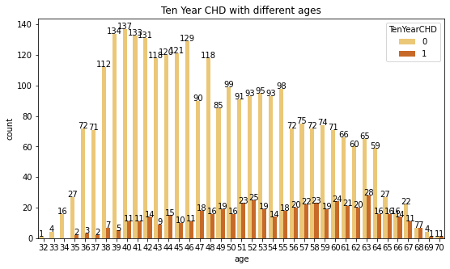
CHD with different ages
Senior age group (>60 years) are at a higher risk of cardiovascular disease
Adults age group (>32 and <47 years) are at a lower risk of cardiovascular disease
Middle-aged adults (>42 and <60 years) are at moderate risk of cardiovascular disease
Therefore, with increasing age, the risk of cardiovascular disease increases

Slide 13
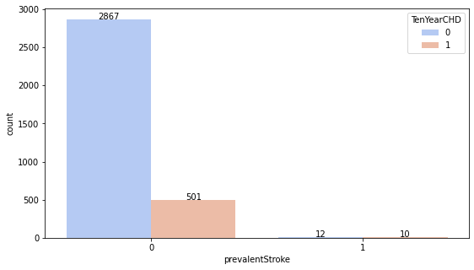
Patients with prevalent Stroke
Out of 22 Hypertensive patients 10 had cardiovascular disease (45%)

Slide 14
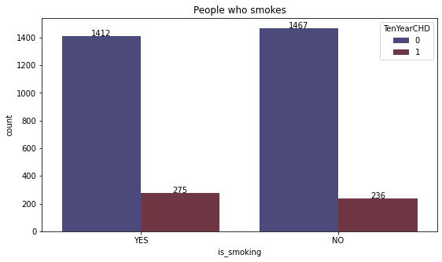
Patients who smokes
Higher percentage of people who are smoking are at high risk.

Slide 15
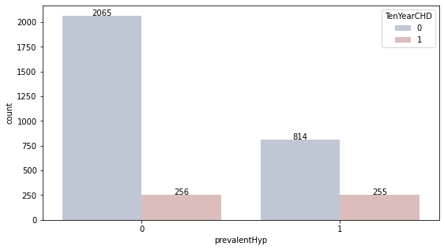
Prevalent Hypertension
People with prevalent hypertension have 50% more chance of getting cardiovascular disease

Slide 16
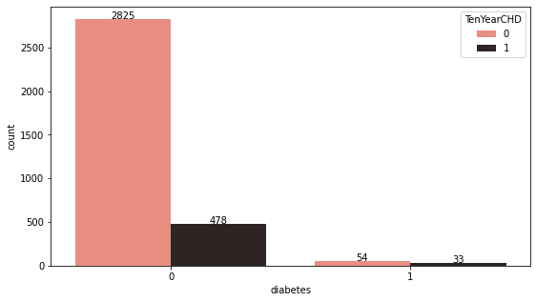
Patient with diabetic
Out of 87 diabetic patients, 35 patients had cardiovascular disease (40%)

Slide 17
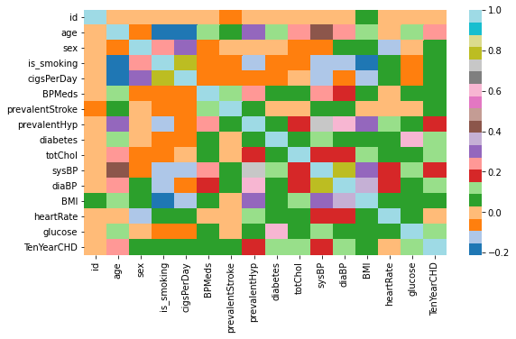
Correlation Heatmap
Most of the given variables don’t have any strong correlation with other variables
diaBP and sysBP are moderately correlated
sysBP is also moderately correlated with prevalentHyp i.e., Prevalent Hypertension
Glucose is also moderately correlated to whether a patient is diabetic
None of the independent variables is strongly correlated with the target variable

Slide 18
Applying ML Algorithms
Since we have to predict whether there is a 10-year risk of future coronary heart disease (CHD) or not, it is a classification problem, and we must use classification algorithms.
We have applied the following algorithms to our data :
Logistic Regression, Ridge Regularization, K neighbors Classifier, Decision Tree Classifier, Random Forest Classifier, Bagging Classifier, XGB Classifier, SVM Classifier

Slide 19
Applying ML Algorithms
Applying supervised ML algorithms has following steps
Preparing data for model
Training model and Hyperparameter tuning
Evaluating model on test data

Slide 20
TRAINING AND HYPERPARAMETER TUNING
We have trained different ML models and performed hyperparameter tuning using Grid Search CV and Random Search.
Grid search
Grid search is arguably the most basic hyperparameter tuning method. With this technique, we simply build a model for each possible combination of all of the hyperparameter values provided, evaluating each model, and selecting the architecture which produces the best results.
Random Search
Random search differs from grid search in that we longer provide a discrete set of values to explore for each hyperparameter; rather, we provide a statistical distribution for each hyperparameter from which values may be randomly sampled.

Slide 21
Model training and validation
Model | Recall Score | Precision | F1- Score | Test Roc – Auc score
Logistic Regression | 0.088 | 0.6 | 0.15 | 0.53
Ridge Regularisation | 0.049 | 0.71 | 0.092 | 0.52
KNN | 0.009 | 0.5 | 0.019 | 0.504
Decision Tree Classifier | 0.010 | 0.5 | 0.019 | 0.504
Random Forest Classifier | 0.049 | 0.5 | 0.089 | 0.520
Bagging Classifier | 0.10 | 0.66 | 0.17 | 0.545
XGB Classifier | 0.52 | 0.31 | 0.3911 | 0.659
We can see that none of the models have performed well as we know that it is an imbalanced dataset so we will make the data set balanced by using SMOTE.

Slide 22
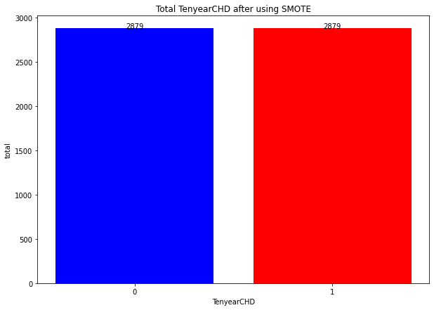
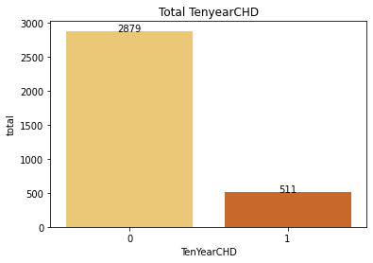
Handling Imbalanced train dataset (SMOTE)
Given data is highly imbalanced in terms of the dependent variable because very few data points are present in a dataset with a value of the dependent variable as 1. This is affecting the accuracy of our model on the test dataset. So to solve this problem we have used an oversampling technique called SMOTE to balance the training dataset.
SMOTE

Slide 23
Model training and validation using smote
Model | Recall Score | Precision | F1- Score | Test Roc – Auc score
KNN | 0.963 | 0.779 | 0.862 | 0.845
Random Forest Classifier | 0.894 | 0.880 | 0.887 | 0.886
SVM Classifier | 0.927 | 0.884 | 0.905 | 0.903
After using SMOTE models performance improved and SVM has the best f1 –score and test score.

Slide 24
Conclusions
Females are more than the number of males in our dataset but the number of males prone to heart disease is more compared to females.
Without using SMOTE all the models were not performing well as the dataset was imbalanced.
So it is necessary to handle the imbalanced dataset.
After using multiple machine learning models we found out that the SVM classifier is the best model for the prediction of CHD for this dataset compared to other classifiers.

Slide 25
THANK YOU

